Slide 1


What is agile

Slide 2

Understand and explore the following topics
What is Agile?
Agile Scrum
Agile Sprint
Agile Project Roles
User Stories
Agile Scrum Workflow
Agile Acceptance Criteria
Sprint Planning Meeting
The Sprint
The Sprint Review
The Sprint Retrospective
Overall Course Objectives

Slide 3
Understand What Agile is
Why you would want to use Agile for your Software Development Project
Appreciate the concept of the Agile Manifesto
Understand and use the 12 Agile Principles to support the Agile Manifesto and the Agile Framework.
Objectives
Of this session

Slide 4
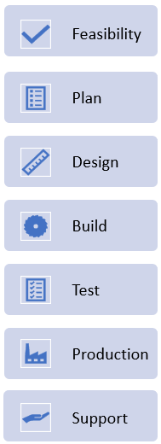
Tons of documentation up front
Business requirements, Application’s architecture
Data structures, Functional designs
User interfaces, non-functional requirements
No coding before all design docs are complete
Then Tests and eventually deploy
Large teams needed, even for a small project
But it worked!
Systems were large, monolithic, clear outcome
Requirements changed slowly
We now require speed, flexibility in a changing world
Before Agile
Waterfall
Can you think of a project where this model would be suitable?

Slide 5

Why Agile?
The dynamic and fast-moving nature of the world today:
Volatility
Uncertainty
Complexity
Ambiguity
In this environment, the assumption that a solution can be designed in detail up-front does not reflect reality.

Slide 6
Agile is the most common software development methodology
It is an evolutionary methodology
The software solution is developed through early prototype or iteration releases
What is Agile
Iterative releases

Slide 7
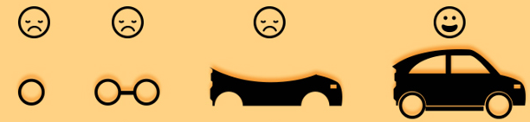

Evolutionary and waterfall comparison

Slide 8
What is important in Agile?
Values
Principles
Practices
Rules
Notes:
Important point!

Slide 9
Requirements not well understood
Difficult to define and express what needed
Iterations uncover understanding
Demo working software to gather feedback
Early delivery more important than completeness
Early benefits – Justify funding £
Quick to market – High value features first
High business/technical risk. If not feasible stop!
Why USE Agile?
When to use Agile?

Slide 10

Agile was Launched in 2001
17 technologists formally drafted the Agile Manifesto
Devised 4 principles for agile software production
Agile

Slide 11
A software development framework is said to be agile if it abides by the agile manifesto.
“We are uncovering better ways of developing software by doing it and helping others do it. Through this work we have come to value:
The Agile manifesto
Individuals and interactions over processes and tools
Working software over comprehensive documentation
Customer collaboration over contract negotiation
Responding to change over following a plan
Notes:
The manifesto was developed in 2001 by 17 leading IT professionals who felt that IT development was failing to meet the growing challenges faced by business. This led to a whole new way of thinking about software development. Linear lifecycles fell out of favour and more evolutionary approaches like Scrum became more popular.
The four values summarised the key points of their combined experience of developing software and helping others develop software. Explanations of each value are:
Individuals and interactions - Self-organization and motivation of individuals and their interactions through co-location and pair programming are more important that a reliance on tools and processes.
Working software - Actual software that works is more useful than documents about what the software will or can do.
Customer collaboration – It is difficult, if not impossible, to specify the requirements fully at the start of the project, therefore continuous customer and stakeholder involvement throughout the project is key rather that defining and agreeing a contract.
Responding to change - Agile development focuses on quick responses to change and continuous development instead of just sticking to the original plan.

Slide 12
We follow these principles:
Our highest priority is to satisfy the customer through early and continuous delivery of valuable software
Welcome changing requirements, even late in development. Agile processes harness change for the customer's competitive advantage
Deliver working software frequently, from a couple of weeks to a couple of months, with a preference to the shorter timescale
Business people and developers must work together daily throughout the project
Build projects around motivated individuals. Give them the environment and support they need, and trust them to get the job done
The most efficient and effective method of conveying information to and within a development team is face-to-face conversation
1
Agile principles 1-6
2
3
4
5
6
Notes:
The Agile Principles are a set of 12 guiding concepts to support project teams when implementing agile projects. The principles should be used to implement agile methodologies in projects. The first six principles are:
Our highest priority is to satisfy the customer through early and continuous delivery of valuable software.
Welcome changing requirements, even late in development. Agile processes harness change for the customer's competitive advantage.
Deliver working software frequently, from a couple of weeks to a couple of months, with a preference to the shorter timescale.
Business people and developers must work together daily throughout the project.
Build projects around motivated individuals. Give them the environment and support they need, and trust them to get the job done.
The most efficient and effective method of conveying information to and within a development team is face-to-face conversation.

Slide 13
Agile principles 7 - 12
7
Working software is the primary measure of progress
Agile processes promote sustainable development. The sponsors, developers, and users should be able to maintain a constant pace indefinitely
Continuous attention to technical excellence and good design enhances agility
Simplicity – the art of maximising the amount of work not done – is essential
The best architectures, requirements, and designs emerge from self-organising teams
At regular intervals, the team reflects on how to become more effective, then tunes and adjusts its behaviour accordingly
8
9
10
11
12
12
Notes:
The second six principles are:
Working software is the primary measure of progress.
Agile processes promote sustainable development. The sponsors, developers, and users should be able to maintain a constant pace indefinitely.
Continuous attention to technical excellence and good design enhances agility.
Simplicity--the art of maximizing the amount of work not done--is essential.
The best architectures, requirements, and designs emerge from self-organizing teams.
At regular intervals, the team reflects on how to become more effective, then tunes and adjusts its behaviour accordingly.

Slide 14
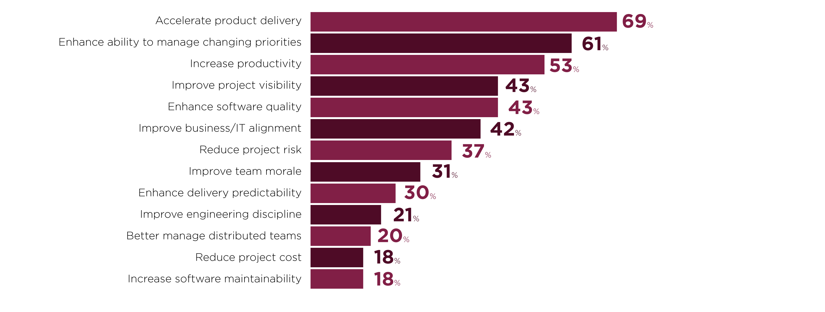
Reasons for adopting Agile
Source: VersionOne 11th Annual State of Agile Report
Respondents were able to make multiple selections.
Notes:
Key Message:
There are many reasons why people adopt Agile the main ones are:
Reduce Time to Market.
Improve the ability to respond to changing requirements.

Slide 15

You now
Review
Understand What Agile is
Can decide if Agile is a go fit for your Software Development Project
Appreciate the concept of the Agile Manifesto
Understand how the 12 Agile Principles to support the Agile Manifesto and the Agile Software Development Framework.

Slide 16
Lab
In Groups, complete Lab1.
Duration 20 minutes

